Slide 1
Computer Security:
Principles and Practice
Fourth Edition
By: William Stallings and Lawrie Brown
Notes:
Lecture slides prepared for “Computer Security: Principles and Practice”, 4/e, by William Stallings and Lawrie Brown, Chapter 4 “Access Control”.

Slide 2
Chapter 4
Access Control
Notes:
We can view access control as a central element of computer security. The principal
objectives of computer security are to prevent unauthorized users from gaining
access to resources, to prevent legitimate users from accessing resources in an unauthorized
manner, and to enable legitimate users to access resources in an authorized
manner.
We begin this chapter with an overview of some important concepts. Next
we look at three widely used techniques for implementing access control policies.
We then turn to a broader perspective of the overall management of access control
using identity, credentials, and attributes. Finally, the concept of a trust framework
is introduced.

Slide 3
Access Control Definitions 1/2
NISTIR 7298 defines access control as:
“the process of granting or denying specific requests to: (1) obtain and use information and related information processing services; and (2) enter specific physical facilities”
Notes:
Two definitions of access control are useful in understanding its scope.
1. NISTIR 7298 (Glossary of Key Information Security Terms , May 2013), defines
access control as the process of granting or denying specific requests to: (1)
obtain and use information and related information processing services; and
(2) enter specific physical facilities.

Slide 4
Access Control Definitions 2/2
RFC 4949 defines access control as:
“a process by which use of system resources is regulated according to a security policy and is permitted only by authorized entities (users, programs, processes, or other systems) according to that policy”
Notes:
2. RFC 4949, Internet Security Glossary , defines access control as a process by
which use of system resources is regulated according to a security policy and
is permitted only by authorized entities (users, programs, processes, or other
systems) according to that policy.

Slide 5
Table 4.1
Access Control Security Requirements ( SP 800-171)
(Table is on page 107 in the textbook)
Notes:
Table 4.1, from NIST SP 800-171 (Protecting Controlled Unclassified Information
in Nonfederal Information Systems and Organizations , August 2016), provides
a useful list of security requirements for access control services.

Slide 6
Access Control Principles
In a broad sense, all of computer security is concerned with access control
RFC 4949 defines computer security as:
“measures that implement and assure security services in a computer system, particularly those that assure access control service”
Notes:
In a broad sense, all of computer security is concerned with access control. Indeed,
RFC 4949 defines computer security as follows: measures that implement and assure
security services in a computer system, particularly those that assure access control
service. This chapter deals with a narrower, more specific concept of access control:
Access control implements a security policy that specifies who or what (e.g., in the
case of a process) may have access to each specific system resource, and the type of
access that is permitted in each instance.

Slide 7
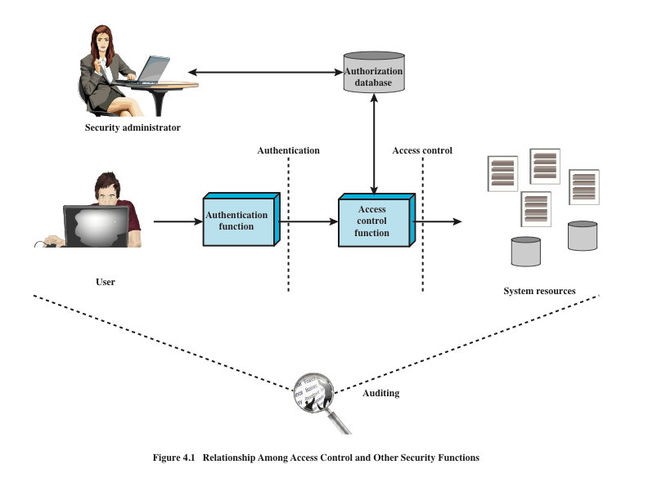
Source: Based on [SAND94].
Source: Based on [SAND94].
Notes:
Figure 4.1 shows a broader context of access control. In addition to access
control, this context involves the following entities and functions:
• Authentication: Verification that the credentials of a user or other system
entity are valid.
Authorization: The granting of a right or permission to a system entity to
access a system resource. This function determines who is trusted for a given
purpose.
• Audit: An independent review and examination of system records and activities
in order to test for adequacy of system controls, to ensure compliance with
established policy and operational procedures, to detect breaches in security,
and to recommend any indicated changes in control, policy and procedures.
An access control mechanism mediates between a user (or a process executing
on behalf of a user) and system resources, such as applications, operating systems,
firewalls, routers, files, and databases. The system must first authenticate an entity
seeking access. Typically, the authentication function determines whether the user
is permitted to access the system at all. Then the access control function determines
if the specific requested access by this user is permitted. A security administrator
maintains an authorization database that specifies what type of access to which
resources is allowed for this user. The access control function consults this database
to determine whether to grant access. An auditing function monitors and keeps a
record of user accesses to system resources.
In the simple model of Figure 4.1, the access control function is shown as
a single logical module. In practice, a number of components may cooperatively
share the access control function. All operating systems have at least a rudimentary,
and in many cases a quite robust, access control component. Add-on security
packages can supplement the native access control capabilities of the OS. Particular
applications or utilities, such as a database management system, also incorporate
access control functions. External devices, such as firewalls, can also provide access
control services.

Slide 8
Access Control Policies
Discretionary access control (DAC)
Controls access based on the identity of the requestor and on access rules (authorizations) stating what requestors are (or are not) allowed to do
Mandatory access control (MAC)
Controls access based on comparing security labels with security clearances
Role-based access control (RBAC)
Controls access based on the roles that users have within the system and on rules stating what accesses are allowed to users in given roles
Attribute-based access control (ABAC)
Controls access based on attributes of the user, the resource to be accessed, and current environmental conditions
Notes:
An access control policy, which can be embodied in an authorization database,
dictates what types of access are permitted, under what circumstances, and by
whom. Access control policies are generally grouped into the following categories:
• Discretionary access control (DAC): Controls access based on the identity
of the requestor and on access rules (authorizations) stating what requestors
are (or are not) allowed to do. This policy is termed discretionary because an
entity might have access rights that permit the entity, by its own volition, to
enable another entity to access some resource.
• Mandatory access control (MAC): Controls access based on comparing
security labels (which indicate how sensitive or critical system resources are)
with security clearances (which indicate system entities are eligible to access
certain resources). This policy is termed mandatory because an entity that has
clearance to access a resource may not, just by its own volition, enable another
entity to access that resource.
• Role-based access control (RBAC): Controls access based on the roles that
users have within the system and on rules stating what accesses are allowed to
users in given roles.
• Attribute-based access control (ABAC): Controls access based on attributes
of the user, the resource to be accessed, and current environmental
conditions.
DAC is the traditional method of implementing access control, and is examined
in Sections 4.3 and 4.4. MAC is a concept that evolved out of requirements for
military information security and is best covered in the context of trusted systems,
which we deal with in Chapter 27. Both RBAC and ABAC have become increasingly
popular, and are examined in Sections 4.5 and 4.6, respectively.
These four policies are not mutually exclusive. An access control mechanism
can employ two or even all three of these policies to cover different classes of system
resources.

Slide 9
Subjects, Objects, and Access Rights
Subject
An entity capable of accessing objects
Three classes
Owner
Group
World
Object
A resource to which access is controlled
Entity used to contain and/or receive information
Access right
Describes the way in which a subject may access an object
Could include:
Read
Write
Execute
Delete
Create
Search
Notes:
The basic elements of access control are: subject, object, and access right.
A subject is an entity capable of accessing objects. Generally, the concept of
subject equates with that of process. Any user or application actually gains access to
an object by means of a process that represents that user or application. The process
takes on the attributes of the user, such as access rights.
A subject is typically held accountable for the actions they have initiated,
and an audit trail may be used to record the association of a subject with security relevant
actions performed on an object by the subject.
Basic access control systems typically define three classes of subject, with
different access rights for each class:
• Owner: This may be the creator of a resource, such as a file. For system resources,
ownership may belong to a system administrator. For project resources, a project
administrator or leader may be assigned ownership.
• Group: In addition to the privileges assigned to an owner, a named group of
users may also be granted access rights, such that membership in the group is
sufficient to exercise these access rights. In most schemes, a user may belong
to multiple groups.
• World: The least amount of access is granted to users who are able to access the
system but are not included in the categories owner and group for this resource.
An object is a resource to which access is controlled. In general, an object
is an entity used to contain and/or receive information. Examples include records,
blocks, pages, segments, files, portions of files, directories, directory trees, mailboxes,
messages, and programs. Some access control systems also encompass, bits,
bytes, words, processors, communication ports, clocks, and network nodes.
The number and types of objects to be protected by an access control system
depends on the environment in which access control operates and the desired tradeoff
between security on the one hand and complexity, processing burden, and ease
of use on the other hand.
An access right describes the way in which a subject may access an object.
Access rights could include the following:
• Read: User may view information in a system resource (e.g., a file, selected
records in a file, selected fields within a record, or some combination). Read
access includes the ability to copy or print.
• Write: User may add, modify, or delete data in system resource (e.g., files,
records, programs). Write access includes read access.
• Execute: User may execute specified programs.
• Delete: User may delete certain system resources, such as files or records.
• Create: User may create new files, records, or fields.
• Search: User may list the files in a directory or otherwise search the directory.

Slide 10
Discretionary Access Control (DAC)
Scheme in which an entity may be granted access rights that permit the entity, by its own violation, to enable another entity to access some resource
Often provided using an access matrix
One dimension consists of identified subjects that may attempt data access to the resources
The other dimension lists the objects that may be accessed
Each entry in the matrix indicates the access rights of a particular subject for a particular object
Notes:
As was previously stated, a discretionary access control scheme is one in which an
entity may be granted access rights that permit the entity, by its own volition, to
enable another entity to access some resource. A general approach to DAC, as
exercised by an operating system or a database management system, is that of an
access matrix. The access matrix concept was formulated by Lampson [LAMP69,
LAMP71], and subsequently refined by Graham and Denning [GRAH72, DENN71]
and by Harrison et al. [HARR76].
One dimension of the matrix consists of identified subjects that may attempt
data access to the resources. Typically, this list will consist of individual users or
user groups, although access could be controlled for terminals, network equipment,
hosts, or applications instead of or in addition to users. The other dimension lists
the objects that may be accessed. At the greatest level of detail, objects may be
individual data fields. More aggregate groupings, such as records, files, or even the
entire database, may also be objects in the matrix. Each entry in the matrix indicates
the access rights of a particular subject for a particular object.

Slide 11
Figure 4.2 Example of Access Control Structures
Notes:
Figure 4.2a, based on a figure in [SAND94], is a simple example of an access
matrix. Thus, user A owns files 1 and 3 and has read and write access rights to those
files. User B has read access rights to file 1, and so on.

Slide 12
Notes:
In practice, an access matrix is usually sparse and is implemented by decomposition in one of two ways. The matrix may be decomposed by columns, yielding access control lists (ACLs); see Figure 4.2b. For each object, an ACL lists users and their permitted access rights. The ACL may contain a default, or public, entry. This allows users that are not explicitly listed as having special rights to have a default set of rights. The default set of rights should always follow the rule of least privilege or read-only access, whichever is applicable. Elements of the list may include individual users as well as groups of users.
When it is desired to determine which subjects have which access rights to a particular resource, ACLs are convenient, because each ACL provides the information for a given resource. However, this data structure is not convenient for determining the access rights available to a specific user.
Decomposition by rows yields capability tickets (Figure 4.2c). A capability
ticket specifies authorized objects and operations for a particular user. Each user
has a number of tickets and may be authorized to loan or give them to others.
Because tickets may be dispersed around the system, they present a greater
security problem than access control lists. The integrity of the ticket must be
protected, and guaranteed (usually by the operating system). In particular, the
ticket must be unforgeable. One way to accomplish this is to have the operating
system hold all tickets on behalf of users. These tickets would have to be held in
a region of memory inaccessible to users. Another alternative is to include an
unforgeable token in the capability. This could be a large random password, or a
cryptographic message authentication code. This value is verified by the relevant
resource whenever access is requested. This form of capability ticket is appropriate
for use in a distributed environment, when the security of its contents cannot
be guaranteed.
The convenient and inconvenient aspects of capability tickets are the opposite
of those for ACLs. It is easy to determine the set of access rights that a given user
has, but more difficult to determine the list of users with specific access rights for a
specific resource.

Slide 13
Table 4.2
Authorization Table
for Files in Figure 4.2
(Table is on page 113 in the textbook)
Notes:
[SAND94] proposes a data structure that is not sparse, like the access matrix,
but is more convenient than either ACLs or capability lists (Table 4.2). An authorization table contains one row for one access right of one subject to one resource. Sorting or accessing the table by subject is equivalent to a capability list. Sorting or accessing the table by object is equivalent to an ACL. A relational database can easily implement an authorization table of this type.

Slide 14
Notes:
This section introduces a general model for DAC developed by Lampson, Graham,
and Denning [LAMP71, GRAH72, DENN71]. The model assumes a set of subjects,
a set of objects, and a set of rules that govern the access of subjects to objects. Let us
define the protection state of a system to be the set of information, at a given point in
time, that specifies the access rights for each subject with respect to each object. We can
identify three requirements: representing the protection state, enforcing access rights,
and allowing subjects to alter the protection state in certain ways. The model addresses
all three requirements, giving a general, logical description of a DAC system.
To represent the protection state, we extend the universe of objects in the
access control matrix to include the following:
• Processes: Access rights include the ability to delete a process, stop (block),
and wake up a process.
• Devices: Access rights include the ability to read/write the device, to control
its operation (e.g., a disk seek), and to block/unblock the device for use.
• Memory locations or regions: Access rights include the ability to read/write
certain regions of memory that are protected such that the default is to disallow
access.
• Subjects: Access rights with respect to a subject have to do with the ability to grant
or delete access rights of that subject to other objects, as explained subsequently.
Figure 4.3 is an example. For an access control matrix A, each entry A[S, X]
contains strings, called access attributes, that specify the access rights of subject S to
object X. For example, in Figure 4.3, S₁ may read file F₁, because ‘read’ appears in
A[S₁, F₁].
From a logical or functional point of view, a separate access control module is
associated with each type of object (Figure 4.4). The module evaluates each request
by a subject to access an object to determine if the access right exists. An access
attempt triggers the following steps:
1. A subject S₀ issues a request of type α for object X.
2. The request causes the system (the operating system or an access control interface
module of some sort) to generate a message of the form (S₀, α, X) to the
controller for X.
3. The controller interrogates the access matrix A to determine if α is in A[S₀, X].
If so, the access is allowed; if not, the access is denied and a protection violation
occurs. The violation should trigger a warning and appropriate action.

Slide 15
Notes:
Figure 4.4 suggests that every access by a subject to an object is mediated
by the controller for that object, and that the controller’s decision is based on the
current contents of the matrix. In addition, certain subjects have the authority to
make specific changes to the access matrix. A request to modify the access matrix is
treated as an access to the matrix, with the individual entries in the matrix treated as
objects. Such accesses are mediated by an access matrix controller, which controls
updates to the matrix.

Slide 16
Table 4.3
Access Control System Commands
(Table is on page 116 in the textbook)
Notes:
The model also includes a set of rules that govern modifications to the access
matrix, shown in Table 4.3. For this purpose, we introduce the access rights ‘owner’
and ‘control’ and the concept of a copy flag, explained in the subsequent paragraphs.
The first three rules deal with transferring, granting, and deleting access rights.
Suppose that the entry α* exists in A[S₀, X]. This means that S₀ has access right α to
subject X and, because of the presence of the copy flag, can transfer this right, with
or without copy flag, to another subject. Rule R1 expresses this capability. A subject
would transfer the access right without the copy flag if there were a concern that
the new subject would maliciously transfer the right to another subject that should
not have that access right. For example, S₁ may place ‘read’ or ‘read*’ in any matrix
entry in the F₁ column. Rule R2 states that if S₀ is designated as the owner of object
X, then S₀ can grant an access right to that object for any other subject. Rule 2 states
that S₀ can add any access right to A[S, X] for any S, if S₀ has ‘owner’ access to x.
Rule R3 permits S₀ to delete any access right from any matrix entry in a row for
which S₀ controls the subject and for any matrix entry in a column for which S₀ owns
the object. Rule R4 permits a subject to read that portion of the matrix that it owns
or controls.
The remaining rules in Table 4.3 govern the creation and deletion of subjects
and objects. Rule R5 states that any subject can create a new object, which it
owns, and can then grant and delete access to the object. Under rule R6, the owner
of an object can destroy the object, resulting in the deletion of the corresponding
column of the access matrix. Rule R7 enables any subject to create a new subject;
the creator owns the new subject and the new subject has control access to itself.
Rule R8 permits the owner of a subject to delete the row and column (if there are
subject columns) of the access matrix designated by that subject.
The set of rules in Table 4.3 is an example of the rule set that could be defined
for an access control system. The following are examples of additional or alternative
rules that could be included. A transfer-only right could be defined, which results in
the transferred right being added to the target subject and deleted from the transferring
subject. The number of owners of an object or a subject could limited to one by
not allowing the copy flag to accompany the owner right.
The ability of one subject to create another subject and to have ‘owner’ access
right to that subject can be used to define a hierarchy of subjects. For example, in
Figure 4.3, S₁ owns S₂ and S₃, so that S₂ and S₃ are subordinate to S₁. By the rules
of Table 4.3, S₁ can grant and delete to S₂ access rights that S₁ already has. Thus,
a subject can create another subject with a subset of its own access rights. This
might be useful, for example, if a subject is invoking an application that is not fully
trusted and does not want that application to be able to transfer access rights to
other subjects.

Slide 17
Protection Domains
Set of objects together with access rights to those objects
More flexibility when associating capabilities with protection domains
In terms of the access matrix, a row defines a protection domain
User can spawn processes with a subset of the access rights of the user
Association between a process and a domain can be static or dynamic
In user mode certain areas of memory are protected from use and certain instructions may not be executed
In kernel mode privileged instructions may be executed and protected areas of memory may be accessed
Notes:
The access control matrix model that we have discussed so far associates a set of
capabilities with a user. A more general and more flexible approach, proposed
in [LAMP71], is to associate capabilities with protection domains. A protection
domain is a set of objects together with access rights to those objects. In terms
of the access matrix, a row defines a protection domain. So far, we have equated
each row with a specific user. So, in this limited model, each user has a protection
domain, and any processes spawned by the user have access rights defined by the
same protection domain.
A more general concept of protection domain provides more flexibility. For
example, a user can spawn processes with a subset of the access rights of the user,
defined as a new protection domain. This limits the capability of the process.
Such a scheme could be used by a server process to spawn processes for different
classes of users. Also, a user could define a protection domain for a program that
is not fully trusted, so that its access is limited to a safe subset of the user’s access
rights.
The association between a process and a domain can be static or dynamic.
For example, a process may execute a sequence of procedures and require different
access rights for each procedure, such as read file and write file. In general,
we would like to minimize the access rights that any user or process has at any
one time; the use of protection domains provides a simple means to satisfy this
requirement.
One form of protection domain has to do with the distinction made in many
operating systems, such as UNIX, between user and kernel mode. A user program
executes in a user mode, in which certain areas of memory are protected from the
user’s use and in which certain instructions may not be executed. When the user
process calls a system routine, that routine executes in a system mode, or what has
come to be called kernel mode, in which privileged instructions may be executed
and in which protected areas of memory may be accessed.

Slide 18
UNIX File Access Control
UNIX files are administered using inodes (index nodes)
Control structures with key information needed for a particular file
Several file names may be associated with a single inode
An active inode is associated with exactly one file
File attributes, permissions and control information are sorted in the inode
On the disk there is an inode table, or inode list, that contains the inodes of all the files in the file system
When a file is opened its inode is brought into main memory and stored in a memory resident inode table
Directories are structured in a hierarchical tree
May contain files and/or other directories
Contains file names plus pointers to associated inodes
Notes:
For our discussion of UNIX file access control, we first introduce several basic
concepts concerning UNIX files and directories.
All types of UNIX files are administered by the operating system by means of
inodes. An inode (index node) is a control structure that contains the key information
needed by the operating system for a particular file. Several file names may be
associated with a single inode, but an active inode is associated with exactly one file,
and each file is controlled by exactly one inode. The attributes of the file as well as
its permissions and other control information are stored in the inode. On the disk,
there is an inode table, or inode list, that contains the inodes of all the files in the file
system. When a file is opened, its inode is brought into main memory and stored in
a memory-resident inode table.
Directories are structured in a hierarchical tree. Each directory can contain
files and/or other directories. A directory that is inside another directory is referred
to as a subdirectory. A directory is simply a file that contains a list of file names plus
pointers to associated inodes. Thus, associated with each directory is its own inode.

Slide 19
UNIX File Access Control
Unique user identification number (user ID)
Member of a primary group identified by a group ID
Belongs to a specific group
12 protection bits
Specify read, write, and execute permission for the owner of the file, members of the group and all other users
The owner ID, group ID, and protection bits are part of the file’s inode
Figure 4.5 UNIX File Access Control
Notes:
Most UNIX systems depend on, or at least are based on, the file access control
scheme introduced with the early versions of UNIX. Each UNIX user is assigned
a unique user identification number (user ID). A user is also a member of a primary
group, and possibly a number of other groups, each identified by a group ID.
When a file is created, it is designated as owned by a particular user and marked
with that user’s ID. It also belongs to a specific group, which initially is either its
creator’s primary group, or the group of its parent directory if that directory has
SetGID permission set. Associated with each file is a set of 12 protection bits. The
owner ID, group ID, and protection bits are part of the file’s inode.
Nine of the protection bits specify read, write, and execute permission for the
owner of the file, other members of the group to which this file belongs, and all other
users. These form a hierarchy of owner, group, and all others, with the highest relevant
set of permissions being used. Figure 4.5a shows an example in which the file owner has
read and write access; all other members of the file’s group have read access, and users
outside the group have no access rights to the file. When applied to a directory, the read
and write bits grant the right to list and to create/rename/delete files in the directory.
The execute bit grants to right to descend into the directory or search it for a filename.

Slide 20
Traditional UNIX File Access Control
“Set user ID”(SetUID)
“Set group ID”(SetGID)
System temporarily uses rights of the file owner/group in addition to the real user’s rights when making access control decisions
Enables privileged programs to access files/resources not generally accessible
Sticky bit
When applied to a directory it specifies that only the owner of any file in the directory can rename, move, or delete that file
Superuser
Is exempt from usual access control restrictions
Has system-wide access
Notes:
The remaining three bits define special additional behavior for files or directories.
Two of these are the “set user ID” (SetUID) and “set group ID” (SetGID)
permissions. If these are set on an executable file, the operating system functions as
follows. When a user (with execute privileges for this file) executes the file, the system
temporarily allocates the rights of the user’s ID of the file creator, or the file’s group,
respectively, to those of the user executing the file. These are known as the “effective
user ID” and “effective group ID” and are used in addition to the “real user ID” and
“real group ID” of the executing user when making access control decisions for this
program. This change is only effective while the program is being executed. This feature
enables the creation and use of privileged programs that may use files normally
inaccessible to other users. It enables users to access certain files in a controlled fashion.
Alternatively, when applied to a directory, the SetGID permission indicates that newly
created files will inherit the group of this directory. The SetUID permission is ignored.
The final permission bit is the “Sticky” bit. When set on a file, this originally
indicated that the system should retain the file contents in memory following execution.
This is no longer used. When applied to a directory, though, it specifies that
only the owner of any file in the directory can rename, move, or delete that file. This
is useful for managing files in shared temporary directories.
One particular user ID is designated as “superuser.” The superuser is
exempt from the usual file access control constraints and has systemwide access.
Any program that is owned by, and SetUID to, the “superuser” potentially grants
unrestricted access to the system to any user executing that program. Hence great
care is needed when writing such programs.
This access scheme is adequate when file access requirements align with users
and a modest number of groups of users. For example, suppose a user wants to give
read access for file X to users A and B and read access for file Y to users B and C. We
would need at least two user groups, and user B would need to belong to both groups
in order to access the two files. However, if there are a large number of different
groupings of users requiring a range of access rights to different files, then a very large
number of groups may be needed to provide this. This rapidly becomes unwieldy and
difficult to manage, even if possible at all. One way to overcome this problem is to use
access control lists, which are provided in most modern UNIX systems.
A final point to note is that the traditional UNIX file access control scheme
implements a simple protection domain structure. A domain is associated with the
user, and switching the domain corresponds to changing the user ID temporarily.

Slide 21
Access Control Lists (ACLs) in UNIX
Modern UNIX systems support ACLs
FreeBSD, OpenBSD, Linux, Solaris
FreeBSD
Setfacl command assigns a list of UNIX user IDs and groups
Any number of users and groups can be associated with a file
Read, write, execute protection bits
A file does not need to have an ACL
Includes an additional protection bit that indicates whether the file has an extended ACL
When a process requests access to a file system object two steps are performed:
Step 1 selects the most appropriate ACL
Step 2 checks if the matching entry contains sufficient permissions
Notes:
Many modern UNIX and UNIX-based operating systems support access control
lists, including FreeBSD, OpenBSD, Linux, and Solaris. In this section, we describe
FreeBSD, but other implementations have essentially the same features and interface.
The feature is referred to as extended access control list, while the traditional
UNIX approach is referred to as minimal access control list.
FreeBSD allows the administrator to assign a list of UNIX user IDs and groups
to a file by using the setfacl command. Any number of users and groups can be
associated with a file, each with three protection bits (read, write, execute), offering a
flexible mechanism for assigning access rights. A file need not have an ACL but may be
protected solely by the traditional UNIX file access mechanism. Free BSD files include
an additional protection bit that indicates whether the file has an extended ACL.

Slide 22
Notes:
FreeBSD and most UNIX implementations that support extended ACLs use
the following strategy (e.g., Figure 4.5b):
1. The owner class and other class entries in the 9-bit permission field have the
same meaning as in the minimal ACL case.
2. The group class entry specifies the permissions for the owner group for this file.
These permissions represent the maximum permissions that can be assigned to
named users or named groups, other than the owning user. In this latter role, the
group class entry functions as a mask.
3. Additional named users and named groups may be associated with the file,
each with a 3-bit permission field. The permissions listed for a named user or
named group are compared to the mask field. Any permission for the named
user or named group that is not present in the mask field is disallowed.
When a process requests access to a file system object, two steps are per formed.
Step 1 selects the ACL entry that most closely matches the requesting process. The ACL
entries are looked at in the following order: owner, named users, (owning or named)
groups, others. Only a single entry determines access. Step 2 checks if the matching entry
contains sufficient permissions. A process can be a member in more than one group; so
more than one group entry can match. If any of these matching group entries contain the
requested permissions, one that contains the requested permissions is picked (the result
is the same no matter which entry is picked). If none of the matching group entries contains
the requested permissions, access will be denied no matter which entry is picked.

Slide 23
Notes:
Traditional DAC systems define the access rights of individual users and groups
of users. In contrast, RBAC is based on the roles that users assume in a system
rather than the user’s identity. Typically, RBAC models define a role as a job function
within an organization. RBAC systems assign access rights to roles instead of
individual users. In turn, users are assigned to different roles, either statically or
dynamically, according to their responsibilities.
RBAC now enjoys widespread commercial use and remains an area of active
research. The National Institute of Standards and Technology (NIST) has issued a
standard, FIPS PUB 140-3, (Security Requirements for Cryptographic Modules September 2009),
that requires support for access control and administration through roles.
The relationship of users to roles is many to many, as is the relationship of
roles to resources, or system objects (Figure 4.6). The set of users changes, in some
environments frequently, and the assignment of a user to one or more roles may
also be dynamic. The set of roles in the system in most environments is relatively
static, with only occasional additions or deletions. Each role will have specific access
rights to one or more resources. The set of resources and the specific access rights
associated with a particular role are also likely to change infrequently.

Slide 24
Notes:
We can use the access matrix representation to depict the key elements of an
RBAC system in simple terms, as shown in Figure 4.7. The upper matrix relates
individual users to roles. Typically there are many more users than roles. Each matrix
entry is either blank or marked, the latter indicating that this user is assigned to this
role. Note that a single user may be assigned multiple roles (more than one mark in a
row) and that multiple users may be assigned to a single role (more than one mark in
a column). The lower matrix has the same structure as the DAC access control matrix,
with roles as subjects. Typically, there are few roles and many objects, or resources.
In this matrix the entries are the specific access rights enjoyed by the roles. Note that a
role can be treated as an object, allowing the definition of role hierarchies.
RBAC lends itself to an effective implementation of the principle of least
privilege, referred to in Chapter 1. Each role should contain the minimum set of
access rights needed for that role. A user is assigned to a role that enables him or her
to perform only what is required for that role. Multiple users assigned to the same
role, enjoy the same minimal set of access rights.

Slide 25
Notes:
A variety of functions and services can be included under the general RBAC
approach. To clarify the various aspects of RBAC, it is useful to define a set of
abstract models of RBAC functionality.
[SAND96] defines a family of reference models that has served as the basis
for ongoing standardization efforts. This family consists of four models that are
related to each other as shown in Figure 4.8a. and Table 4.4. RBAC₀ contains the
minimum functionality for an RBAC system. RBAC₁ includes the RBAC₀ functionality
and adds role hierarchies, which enable one role to inherit permissions
from another role. RBAC₂ includes RBAC₀ and adds constraints, which restrict
the ways in which the components of a RBAC system may be configured. RBAC₃
contains the functionality of RBAC₀, RBAC₁, and RBAC₂.
RBAC₀ Figure 4.8b, without the role hierarchy and constraints,
contains the four types of entities in an RBAC₀ system:
• User: An individual that has access to this computer system. Each individual
has an associated user ID.
Role: A named job function within the organization that controls this computer
system. Typically, associated with each role is a description of the authority and
responsibility conferred on this role, and on any user who assumes this role.
• Permission: An approval of a particular mode of access to one or more objects.
Equivalent terms are access right, privilege, and authorization.
• Session: A mapping between a user and an activated subset of the set of roles
to which the user is assigned.
The arrowed lines in Figure 4.8b indicate relationships, or mappings, with a
single arrowhead indicating one and a double arrowhead indicating many. Thus,
there is a many-to-many relationship between users and roles: One user may have
multiple roles, and multiple users may be assigned to a single role. Similarly, there
is a many-to-many relationship between roles and permissions. A session is used to
define a temporary one-to-many relationship between a user and one or more of the
roles to which the user has been assigned. The user establishes a session with only the
roles needed for a particular task; this is an example of the concept of least privilege.
The many-to-many relationships between users and roles and between roles
and permissions provide a flexibility and granularity of assignment not found in
conventional DAC schemes. Without this flexibility and granularity, there is a greater
risk that a user may be granted more access to resources than is needed because
of the limited control over the types of access that can be allowed. The NIST RBAC
document gives the following examples: Users may need to list directories and modify
existing files without creating new files, or they may need to append
records to a file without modifying existing records.

Slide 26
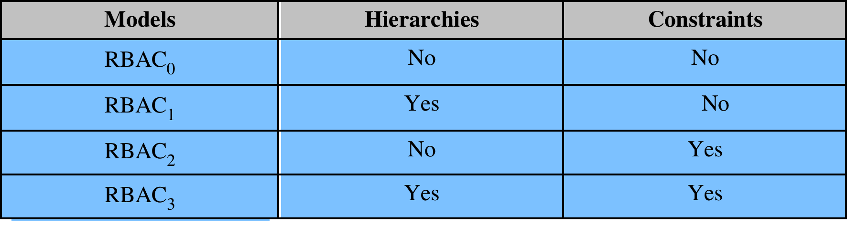
Table 4.4 Scope RBAC Models
Notes:
Scope RBAC Models.

Slide 27
Notes:
Role hierarchies provide a means of reflecting
the hierarchical structure of roles in an organization. Typically, job functions with
greater responsibility have greater authority to access resources. A subordinate job
function may have a subset of the access rights of the superior job function. Role
hierarchies make use of the concept of inheritance to enable one role to implicitly
include access rights associated with a subordinate role.
Figure 4.9 is an example of a diagram of a role hierarchy. By convention, subordinate
roles are lower in the diagram. A line between two roles implies that the
upper role includes all of the access rights of the lower role, as well as other access
rights not available to the lower role. One role can inherit access rights from multiple
subordinate roles. For example, in Figure 4.9, the Project Lead role includes all of
the access rights of the Production Engineer role and of the Quality Engineer role.
More than one role can inherit from the same subordinate role. For example, both
the Production Engineer role and the Quality Engineer role include all of the access
rights of the Engineer role. Additional access rights are also assigned to the Production
Engineer Role and a different set of additional access rights are assigned to the
Quality Engineer role. Thus, these two roles have overlapping access rights, namely
the access rights they share with the Engineer role.

Slide 28
Constraints - RBAC
Provide a means of adapting RBAC to the specifics of administrative and security policies of an organization
A defined relationship among roles or a condition related to roles
Types:
Mutually exclusive roles
A user can only be assigned to one role in the set (either during a session or statically)
Any permission (access right) can be granted to only one role in the set
Cardinality
Setting a maximum number with respect to roles
Prerequisite roles
Dictates that a user can only be assigned to a particular role if it is already assigned to some other specified role
Notes:
Constraints provide a means of adapting RBAC to the
specifics of administrative and security policies in an organization. A constraint is
a defined relationship among roles or a condition related to roles. [SAND96] lists
the following types of constraints: mutually exclusive roles, cardinality, and prerequisite
roles.
Mutually exclusive roles are roles such that a user can be assigned to only
one role in the set. This limitation could be a static one, or it could be dynamic, in
the sense that a user could be assigned only one of the roles in the set for a session.
The mutually exclusive constraint supports a separation of duties and capabilities
within an organization. This separation can be reinforced or enhanced by use of
mutually exclusive permission assignments. With this additional constraint, a mutually
exclusive set of roles has the following properties:
1. A user can only be assigned to one role in the set (either during a session or
statically).
2. Any permission (access right) can be granted to only one role in the set.
Thus the set of mutually exclusive roles have non-overlapping permissions. If two
users are assigned to different roles in the set, then the users have non-overlapping
permissions while assuming those roles. The purpose of mutually exclusive roles is to
increase the difficulty of collusion among individuals of different skills or divergent job
functions to thwart security policies.
Cardinality refers to setting a maximum number with respect to roles. One
such constraint is to set a maximum number of users that can be assigned to a given
role. For example, a project leader role or a department head role might be limited
to a single user. The system could also impose a constraint on the number of roles
that a user is assigned to, or the number of roles a user can activate for a single session.
Another form of constraint is to set a maximum number of roles that can be
granted a particular permission; this might be a desirable risk mitigation technique
for a sensitive or powerful permission.
A system might be able to specify a prerequisite role, which dictates that a user can
only be assigned to a particular role if it is already assigned to some other specified
role. A prerequisite can be used to structure the implementation of the least privilege
concept. In a hierarchy, it might be required that a user can be assigned to a senior
(higher) role only if it is already assigned an immediately junior (lower) role. For
example, in Figure 4.9 a user assigned to a Project Lead role must also be assigned
to the subordinate Production Engineer and Quality Engineer roles. Then, if the user
does not need all of the permissions of the Project Lead role for a given task, the user
can invoke a session using only the required subordinate role. Note that the use of
prerequisites tied to the concept of hierarchy requires the RBAC₃ model.

Slide 29
Attribute-Based Access Control (ABAC)
Can define authorizations that express conditions on properties of both the resource and the subject
Strength is its flexibility and expressive power
Main obstacle to its adoption in real systems has been concern about the performance impact of evaluating predicates on both resource and user properties for each access
Web services have been pioneering technologies through the introduction of the eXtensible Access Control Markup Language (XAMCL)
There is considerable interest in applying the model to cloud services
Notes:
A relatively recent development in access control technology is the attribute-based
access control (ABAC) model. An ABAC model can define authorizations that
express conditions on properties of both the resource and the subject. For example,
consider a configuration in which each resource has an attribute that identifies the
subject that created the resource. Then, a single access rule can specify the ownership
privilege for all the creators of every resource. The strength of the ABAC
approach is its flexibility and expressive power. [PLAT13] points out that the main
obstacle to its adoption in real systems has been concern about the performance
impact of evaluating predicates on both resource and user properties for each
access. However, for applications such as cooperating Web services and cloud computing,
this increased performance cost is less noticeable because there is already a
relatively high performance cost for each access. Thus, Web services have been pioneering
technologies for implementing ABAC models, especially through the introduction
of the eXtensible Access Control Markup Language (XAMCL) [BEUC13],
and there is considerable interest in applying the ABAC model to cloud services
[IQBA12, YANG12].
There are three key elements to an ABAC model: attributes, which are defined
for entities in a configuration; a policy model, which defines the ABAC policies; and
the architecture model, which applies to policies that enforce access control. We
examine these elements in turn.

Slide 30
ABAC Model: Attributes
Subject attributes
A subject is an active entity that causes information to flow among objects or changes the system state
Object attributes
An object (or resource) is a passive information system-related entity containing or receiving information
Environment attributes
Describe the operational, technical, and even situational environment or context in which the information access occurs
Attributes define the identity and characteristics of the subject
Objects have attributes that can be leverages to make access control decisions
These attributes have so far been largely ignored in most access control policies
Notes:
Attributes are characteristics that define specific aspects of the subject, object, environment
conditions, and/or requested operations that are predefined and preassigned
by an authority. Attributes contain information that indicates the class of information
given by the attribute, a name, and a value (e.g., Class=HospitalRecordsAccess,
Name=PatientInformationAccess, Value=MFBusinessHoursOnly).
The following are the three types of attributes in the ABAC model:
• Subject attributes: A subject is an active entity (e.g., a user, an application, a
process, or a device) that causes information to flow among objects or changes
the system state. Each subject has associated attributes that define the identity
and characteristics of the subject. Such attributes may include the subject’s
identifier, name, organization, job title, and so on. A subject’s role can also be
viewed as an attribute.
• Object attributes: An object, also referred to as a resource , is a passive (in the
context of the given request) information system-related entity (e.g., devices,
files, records, tables, processes, programs, networks, domains) containing or
receiving information. As with subjects, objects have attributes that can be
leveraged to make access control decisions. A Microsoft Word document, for
example, may have attributes such as title, subject, date, and author. Object
attributes can often be extracted from the metadata of the object. In particular,
a variety of Web service metadata attributes may be relevant for access
control purposes, such as ownership, service taxonomy, or even Quality of
Service (QoS) attributes.
• Environment attributes: These attributes have so far been largely ignored in
most access control policies. They describe the operational, technical, and even
situational environment or context in which the information access occurs. For
example, attributes, such as current date and time, the current virus/hacker
activities, and the network’s security level (e.g., Internet vs. intranet), are not
associated with a particular subject nor a resource, but may nonetheless be
relevant in applying an access control policy.

Slide 31
ABAC
Distinguishable because it controls access to objects by evaluating rules against the attributes of entities, operations, and the environment relevant to a request
Relies upon the evaluation of attributes of the subject, attributes of the object, and a formal relationship or access control rule defining the allowable operations for subject-object attribute combinations in a given environment
Systems are capable of enforcing DAC, RBAC, and MAC concepts
Allows an unlimited number of attributes to be combined to satisfy any access control rule
Notes:
ABAC is a logical access control model that is distinguishable because it controls
access to objects by evaluating rules against the attributes of entities (subject
and object), operations, and the environment relevant to a request. ABAC relies
upon the evaluation of attributes of the subject, attributes of the object, and a formal
relationship or access control rule defining the allowable operations for subject-object
attribute combinations in a given environment. All ABAC solutions contain
these basic core capabilities to evaluate attributes and enforce rules or relationships
between those attributes. ABAC systems are capable of enforcing DAC, RBAC,
and MAC concepts. ABAC enables fine-grained access control, which allows for a
higher number of discrete inputs into an access control decision, providing a bigger
set of possible combinations of those variables to reflect a larger and more definitive
set of possible rules, policies, or restrictions on access. Thus, ABAC allows an
unlimited number of attributes to be combined to satisfy any access control rule.
Moreover, ABAC systems can be implemented to satisfy a wide array of requirements
from basic access control lists through advanced expressive policy models
that fully leverage the flexibility of ABAC.

Slide 32
Notes:
Figure 4.10 illustrates in a logical architecture the essential components of an ABAC
system. An access by a subject to an object proceeds according to the following steps:
1. A subject requests access to an object. This request is routed to an access control
mechanism.
2. The access control mechanism is governed by a set of rules (2a) that are defined
by a preconfigured access control policy. Based on these rules, the access control
mechanism assesses the attributes of the subject (2b), object (2c), and current
environmental conditions (2d) to determine authorization.
3. The access control mechanism grants the subject access to the object if access
is authorized and denies access if it is not authorized.
It is clear from the logical architecture that there are four independent sources
of information used for the access control decision. The system designer can decide
which attributes are important for access control with respect to subjects, objects,
and environmental conditions. The system designer or other authority can then
define access control policies, in the form of rules, for any desired combination of
attributes of subject, object, and environmental conditions. It should be evident that
this approach is very powerful and flexible. However, the cost, both in terms of
the complexity of the design and implementation and in terms of the performance
impact, is likely to exceed that of other access control approaches. This is a tradeoff
that the system authority must make.

Slide 33
Notes:
Figure 4.11, taken from NIST SP 800-162 [Guide to Attribute Based Access Control
(ABAC) Definition and Considerations, January 2014],
provides a useful way of grasping the scope of an ABAC model compared to a DAC model using access
control lists (ACLs). This figure not only illustrates the relative complexity of the
two models, but also clarifies the trust requirements of the two models. A comparison
of representative trust relationships (indicated by arrowed lines) for ACL
use and ABAC use shows that there are many more complex trust relationships
required for ABAC to work properly. Ignoring the commonalities in both parts
of Figure 4.11, one can observe that with ACLs the root of trust is with the object
owner, who ultimately enforces the object access rules by provisioning access to
the object through addition of a user to an ACL. In ABAC, the root of trust is
derived from many sources of which the object owner has no control, such as Subject
Attribute Authorities, Policy Developers, and Credential Issuers. Accordingly,
SP 800‑162 recommended that an enterprise governance body be formed to manage
all identity, credential, and access management capability deployment and operation
and that each subordinate organization maintain a similar body to ensure consistency
in managing the deployment and paradigm shift associated with enterprise
ABAC implementation. Additionally, it is recommended that an enterprise develop
a trust model that can be used to illustrate the trust relationships and help determine
ownership and liability of information and services, needs for additional policy and
governance, and requirements for technical solutions to validate or enforce trust
relationships. The trust model can be used to help influence organizations to share
their information with clear expectations of how that information will be used and
protected and to be able to trust the information and attribute and authorization
assertions coming from other organizations.

Slide 34
ABAC Policies
A policy is a set of rules and relationships that govern allowable behavior within an organization, based on the privileges of subjects and how resources or objects are to be protected under which environment conditions
Typically written from the perspective of the object that needs protecting and the privileges available to subjects
Privileges represent the authorized behavior of a subject and are defined by an authority and embodied in a policy
Other terms commonly used instead of privileges are: rights, authorizations, and entitlements
Notes:
A policy is a set of rules and relationships that govern allowable behavior within an
organization, based on the privileges of subjects and how resources or objects are to
be protected under which environment conditions. In turn, privileges represent the
authorized behavior of a subject; they are defined by an authority and embodied in
a policy. Other terms that are commonly used instead of privileges are rights, authorizations,and entitlements . Policy is typically written from the perspective of the object that needs protecting and the privileges available to subjects.

Slide 35
Identity, Credential, and Access Management (ICAM)
A comprehensive approach to managing and implementing digital identities, credentials, and access control
Developed by the U.S. government
Designed to:
Create trusted digital identity representations of individuals and nonperson entities (NPEs)
Bind those identities to credentials that may serve as a proxy for the individual of NPE in access transactions
A credential is an object or data structure that authoritatively binds an identity to a token possessed and controlled by a subscriber
Use the credentials to provide authorized access to an agency’s resources
Notes:
We now examine some concepts that are relevant to an access control approach
centered on attributes. This section provides an overview of the concept of identity,
credential, and access management (ICAM), and then Section 4.8 discusses the use
of a trust framework for exchanging attributes.
ICAM is a comprehensive approach to managing and implementing digital
identities (and associated attributes), credentials, and access control. ICAM has
been developed by the U.S. government, but is applicable not only to government
agencies, but also may be deployed by enterprises looking for a unified approach to
access control. ICAM is designed to
• Create trusted digital identity representations of individuals and what the
ICAM documents refer to as nonperson entities (NPEs). The latter include
processes, applications, and automated devices seeking access to a resource.
• Bind those identities to credentials that may serve as a proxy for the individual
or NPE in access transactions. A credential is an object or data structure that
authoritatively binds an identity (and optionally, additional attributes) to a
token possessed and controlled by a subscriber.
• Use the credentials to provide authorized access to an agency’s resources.

Slide 36
Notes:
Figure 4.12 provides an overview of the logical components of an ICAM architecture.
We examine each of the main components in the following subsections.

Slide 37
Identity Management
Concerned with assigning attributes to a digital identity and connecting that digital identity to an individual or NPE
Goal is to establish a trustworthy digital identity that is independent of a specific application or context
Most common approach to access control for applications and programs is to create a digital representation of an identity for the specific use of the application or program
Maintenance and protection of the identity itself is treated as secondary to the mission associated with the application
Final element is lifecycle management which includes:
Mechanisms, policies, and procedures for protecting personal identity information
Controlling access to identity data
Techniques for sharing authoritative identity data with applications that need it
Revocation of an enterprise identity
Notes:
Identity management is concerned with assigning attributes to a digital identity and
connecting that digital identity to an individual or NPE. The goal is to establish a
trustworthy digital identity that is independent of a specific application or context.
The traditional, and still most common approach, to access control for applications
and programs is to create a digital representation of an identity for the specific use
of the application or program. As a result, maintenance and protection of the identity
itself is treated as secondary to the mission associated with the application. Further,
there is considerable overlap in effort in establishing these application-specific
identities.
Unlike accounts used to logon to networks, systems, or applications, enterprise
identity records are not tied to job title, job duties, location, or whether access is
needed to a specific system. Those items may become attributes tied to an enterprise
identity record, and may also become part of what uniquely identifies an individual
in a specific application. Access control decisions will be based on the context and
relevant attributes of a user—not solely their identity. The concept of an enterprise
identity is that individuals will have a single digital representation of themselves that
can be leveraged across departments and agencies for multiple purposes, including
access control.
Figure 4.12 depicts the key functions involved in identity management. Establishment
of a digital identity typically begins with collecting identity data as part of
an on-boarding process. A digital identity is often comprised of a set of attributes
that when aggregated uniquely identify a user within a system or an enterprise. In
order to establish trust in the individual represented by a digital identity, an agency
may also conduct a background investigation. Attributes about an individual may be
stored in various authoritative sources within an agency and linked to form an enterprise
view of the digital identity. This digital identity may then be provisioned into
applications in order to support physical and logical access (part of Access Management)
and de-provisioned when access is no longer required.
A final element of identity management is lifecycle management, which
includes the following:
• Mechanisms, policies, and procedures for protecting personal identity
information
• Controlling access to identity data
• Techniques for sharing authoritative identity data with applications that need it
• Revocation of an enterprise identity

Slide 38
Credential Management
The management of the life cycle of the credential
Examples of credentials are smart cards, private/public cryptographic keys, and digital certificates
Encompasses five logical components:
An authorized individual sponsors an individual or entity for a credential to establish the need for the credential
The sponsored individual enrolls for the credential
Process typically consists of identity proofing and the capture of biographic and biometric data
This step may also involve incorporating authoritative attribute data, maintained by the identity management component
A credential is produced
Depending on the credential type, production may involve encryption, the use of a digital signature, the production of a smart card or other functions
The credential is issued to the individual or NPE
A credential must be maintained over its life cycle
Might include revocation, reissuance/replacement, reenrollment, expiration, personal identification number (PIN) reset, suspension, or reinstatement
Notes:
As mentioned, a credential is an object or data structure that authoritatively binds
an identity (and optionally, additional attributes) to a token possessed and controlled
by a subscriber. Examples of credentials are smart cards, private/public cryptographic
keys, and digital certificates. Credential management is the management
of the life cycle of the credential. Credential management encompasses the following
five logical components:
1. An authorized individual sponsors an individual or entity for a credential to
establish the need for the credential. For example, a department supervisor
sponsors a department employee.
2. The sponsored individual enrolls for the credential, a process which typically consists
of identity proofing and the capture of biographic and biometric data. This
step may also involve incorporating authoritative attribute data, maintained by
the identity management component.
3. A credential is produced. Depending on the credential type, production may
involve encryption, the use of a digital signature, the production of a smartcard,
or other functions.
4. The credential is issued to the individual or NPE.
5. Finally, a credential must be maintained over its life cycle, which might include
revocation, reissuance/replacement, reenrollment, expiration, personal identification
number (PIN) reset, suspension, or reinstatement.

Slide 39
Access Management
Deals with the management and control of the ways entities are granted access to resources
Covers both logical and physical access
May be internal to a system or an external element
Purpose is to ensure that the proper identity verification is made when an individual attempts to access a security sensitive building, computer systems, or data
Three support elements are needed for an enterprise-wide access control facility:
Resource management
Privilege management
Policy management
Notes:
The access management component deals with the management and control of the
ways entities are granted access to resources. It covers both logical and physical
access, and may be internal to a system or an external element. The purpose of
access management is to ensure that the proper identity verification is made when
an individual attempts to access security sensitive buildings, computer systems,
or data. The access control function makes use of credentials presented by those
requesting access and the digital identity of the requestor. Three support elements
are needed for an enterprise-wide access control facility:
• Resource management
• Privilege management
• Policy management

Slide 40
Three support elements are needed for an enterprise-wide access control facility:
Resource management
Concerned with defining rules for a resource that requires access control
Rules would include credential requirements and what user attributes, resource attributes, and environmental conditions are required for access of a given resource for a given function
Privilege management
Concerned with establishing and maintaining the entitlement or privilege attributes that comprise an individual’s access profile
These attributes represent features of an individual that can be used as the basis for determining access decisions to both physical and logical resources
Privileges are considered attributes that can be linked to a digital identity
Policy management
Governs what is allowable and unallowable in an access transaction
Notes:
Three support elements
are needed for an enterprise-wide access control facility:
• Resource management: This element is concerned with defining rules for
a resource that requires access control. The rules would include credential
requirements and what user attributes, resource attributes, and environmental
conditions are required for access of a given resource for a given
function.
• Privilege management: This element is concerned with establishing and maintaining
the entitlement or privilege attributes that comprise an individual’s
access profile. These attributes represent features of an individual that can be
used as the basis for determining access decisions to both physical and logical
resources. Privileges are considered attributes that can be linked to a digital
identity.
• Policy management: This element governs what is allowable and unallowable
in an access transaction. That is, given the identity and attributes of
the requestor, the attributes of the resource or object, and environmental
conditions, a policy specifies what actions this user can perform on this
object.

Slide 41
Identity Federation
Term used to describe the technology, standards, policies, and processes that allow an organization to trust digital identities, identity attributes, and credentials created and issued by another organization
Addresses two questions:
How do you trust identities of individuals from external organizations who need access to your systems
How do you vouch for identities of individuals in your organization when they need to collaborate with external organizations
Notes:
Identity federation addresses two questions:
1. How do you trust identities of individuals from external organizations who
need access to your systems?
2. How do you vouch for identities of individuals in your organization when they
need to collaborate with external organizations?
Identity federation is a term used to describe the technology, standards, policies,
and processes that allow an organization to trust digital identities, identity
attributes, and credentials created and issued by another organization. We discuss
identity federation in the following section.

Slide 42
Notes:
Online or network transactions involving parties from different organizations, or
between an organization and an individual user such as an online customer, generally
require the sharing of identity information. This information may include a host
of associated attributes in addition to a simple name or numerical identifier. Both
the party disclosing the information and the party receiving the information need
to have a level of trust about security and privacy issues related to that information.
Figure 4.13a shows the traditional technique for the exchange of identity information.
This involves users developing arrangements with an identity service provider
to procure digital identity and credentials, and arrangements with parties that
provide end-user services and applications and that are willing to rely on the identity
and credential information generated by the identity service provider.
The arrangement of Figure 4.13a must meet a number of requirements. The
relying party requires that the user has been authenticated to some degree of assurance,
that the attributes imputed to the user by the identity service provider are
accurate, and that the identity service provider is authoritative for those attributes.
The identity service provider requires assurance that it has accurate information
about the user and that, if it shares information, the relying party will use it in
accordance with contractual terms and conditions and the law. The user requires
assurance that the identity service provider and relying party can be entrusted with
sensitive information and that they will abide by the user’s preferences and respect
the user’s privacy. Most importantly, all the parties want to know if the practices
described by the other parties are actually those implemented by the parties, and
how reliable those parties are.

Slide 43
Open Identity Trust Framework
OpenID
An open standard that allows users to be authenticated by certain cooperating sites using a third party service
OIDF
OpenID Foundation is an international nonprofit organization of individuals and companies committed to enabling, promoting, and protecting OpenID technologies
ICF
Information Card Foundation is a nonprofit community of companies and individuals working together to evolve the Information Card ecosystem
OITF
Open Identity Trust Framework is a standardized, open specification of a trust framework for identity and attribute exchange, developed jointly by OIDF and ICF
OIX
Open Identity Exchange Corporation is an independent, neutral, international provider of certification trust frameworks conforming to the OITF model
AXN
Attribute Exchange Network is an online Internet-scale gateway for identity service providers and relying parties to efficiently access user asserted, permissioned, and verified online identity attributes in high volumes at affordable costs
Notes:
Without some universal standard and framework, the arrangement of Figure 4.13a
must be replicated in multiple contexts. A far preferable approach is to develop an
open, standardized approach to trustworthy identity and attribute exchange. In the
remainder of this section, we examine such an approach that is gaining increasing
acceptance.
Unfortunately, this topic is burdened with numerous acronyms, so it is best to
begin with a definition of the most important of these:
• OpenID: This is an open standard that allows users to be authenticated by certain
cooperating sites (known as Relying Parties) using a third party service,
eliminating the need for Webmasters to provide their own ad hoc systems and
allowing users to consolidate their digital identities. Users may create accounts
with their preferred OpenID identity providers, and then use those accounts as
the basis for signing on to any website which accepts OpenID authentication.
• OIDF: The OpenID Foundation is an international nonprofit organization of
individuals and companies committed to enabling, promoting, and protecting
OpenID technologies. OIDF assists the community by providing needed infrastructure
and help in promoting and supporting expanded adoption of OpenID.
• ICF: The Information Card Foundation is a nonprofit community of companies
and individuals working together to evolve the Information Card ecosystem.
Information Cards are personal digital identities that people can use
online, and the key component of identity metasystems. Visually, each Information
Card has a card-shaped picture and a card name associated with it that
enable people to organize their digital identities and to easily select one they
want to use for any given interaction.
• OITF: The Open Identity Trust Framework is a standardized, open specification
of a trust framework for identity and attribute exchange, developed
jointly by OIDF and ICF.
• OIX: The Open Identity Exchange Corporation is an independent, neutral,
international provider of certification trust frameworks conforming to the
Open Identity Trust Frameworks model.
• AXN: An Attribute Exchange Network (AXN) is an online Internet-scale
gateway for identity service providers and relying parties to efficiently access
user asserted, permissioned, and verified online identity attributes in high volumes
at affordable costs.
System managers need to be able to trust that the attributes associated with
a subject or an object are authoritative and are exchanged securely. One approach
to providing that trust within an organization is the ICAM model, specifically the
ICAM components (Figure 4.12). Combined with an identity federation functionality
that is shared with other organizations, attributes can be exchanged in a trustworthy
fashion, supporting secure access control.
In digital identity systems, a trust framework functions as a certification program.
It enables a party who accepts a digital identity credential (called the relying
party) to trust the identity, security, and privacy policies of the party who issues
the credential (called the identity service provider) and vice versa. More formally,
OIX defines a trust framework as a set of verifiable commitments from each of the
various parties in a transaction to their counter parties. These commitments include
(1) controls (including regulatory and contractual obligations) to help ensure commitments
are delivered and (2) remedies for failure to meet such commitments. A
trust framework is developed by a community whose members have similar goals
and perspectives. It defines the rights and responsibilities of that community’s participants;
specifies the policies and standards specific to the community; and defines
the community-specific processes and procedures that provide assurance. Different
trust frameworks can exist, and sets of participants can tailor trust frameworks to
meet their particular needs.

Slide 44
Notes:
Figure 4.13b shows the elements involved in the OITF. Within any given organization
or agency, the following roles are part of the overall framework:
• Relying parties (RPs): Also called service providers, these are entities delivering
services to specific users. RPs must have confidence in the identities and/or
attributes of their intended users, and must rely upon the various credentials
presented to evince those attributes and identities.
• Subjects: These are users of an RP’s services, including customers, employees,
trading partners, and subscribers.
• Attribute providers (APs): APs are entities acknowledged by the community
of interest as being able to verify given attributes as presented by subjects
and which are equipped through the AXN to create conformant attribute credentials
according to the rules and agreements of the AXN. Some APs will
be sources of authority for certain information; more commonly APs will be
brokers of derived attributes.
• Identity providers (IDPs): These are entities able to authenticate user credentials
and to vouch for the names (or pseudonyms or handles) of subjects, and
which are equipped through the AXN or some other compatible Identity and
Access Management (IDAM) system to create digital identities that may be
used to index user attributes.
There are also the following important support elements as part on an AXN:
• Assessors: Assessors evaluate identity service providers and RPs and certify
that they are capable of following the OITF provider’s blueprint.
• Auditors: These entities may be called on to check that parties’ practices have
been in line with what was agreed for the OITF.
• Dispute resolvers: These entities provide arbitration and dispute resolution
under OIX guidelines.
• Trust framework providers: A trust framework provider is an organization
that translates the requirements of policymakers into an own blueprint for a
trust framework that it then proceeds to build, doing so in a way that is consistent
with the minimum requirements set out in the OITF specification. In
almost all cases, there will be a reasonably obvious candidate organization to
take on this role, for each industry sector or large organization that decides it
is appropriate to interoperate with an AXN.
The solid arrowed lines in Figure 4.13b indicate agreements with the trust
framework provider for implementing technical, operations, and legal requirements.
The dashed arrowed lines indicate other agreements potentially affected
by these requirements. In general terms, the model illustrated in Figure 4.13b
would operate in the following way. Responsible persons within participating
organizations determine the technical, operational, and legal requirements for
exchanges of identity information that fall under their authority. They then select
OITF providers to implement these requirements. These OITF providers translate
the requirements into a blueprint for a trust framework that may include additional
conditions of the OITF provider. The OITF provider vets identity service
providers and RPs and contracts with them to follow its trust framework requirements
when conducting exchanges of identity information. The contracts carry
provisions relating to dispute resolvers and auditors for contract interpretation
and enforcement.

Slide 45
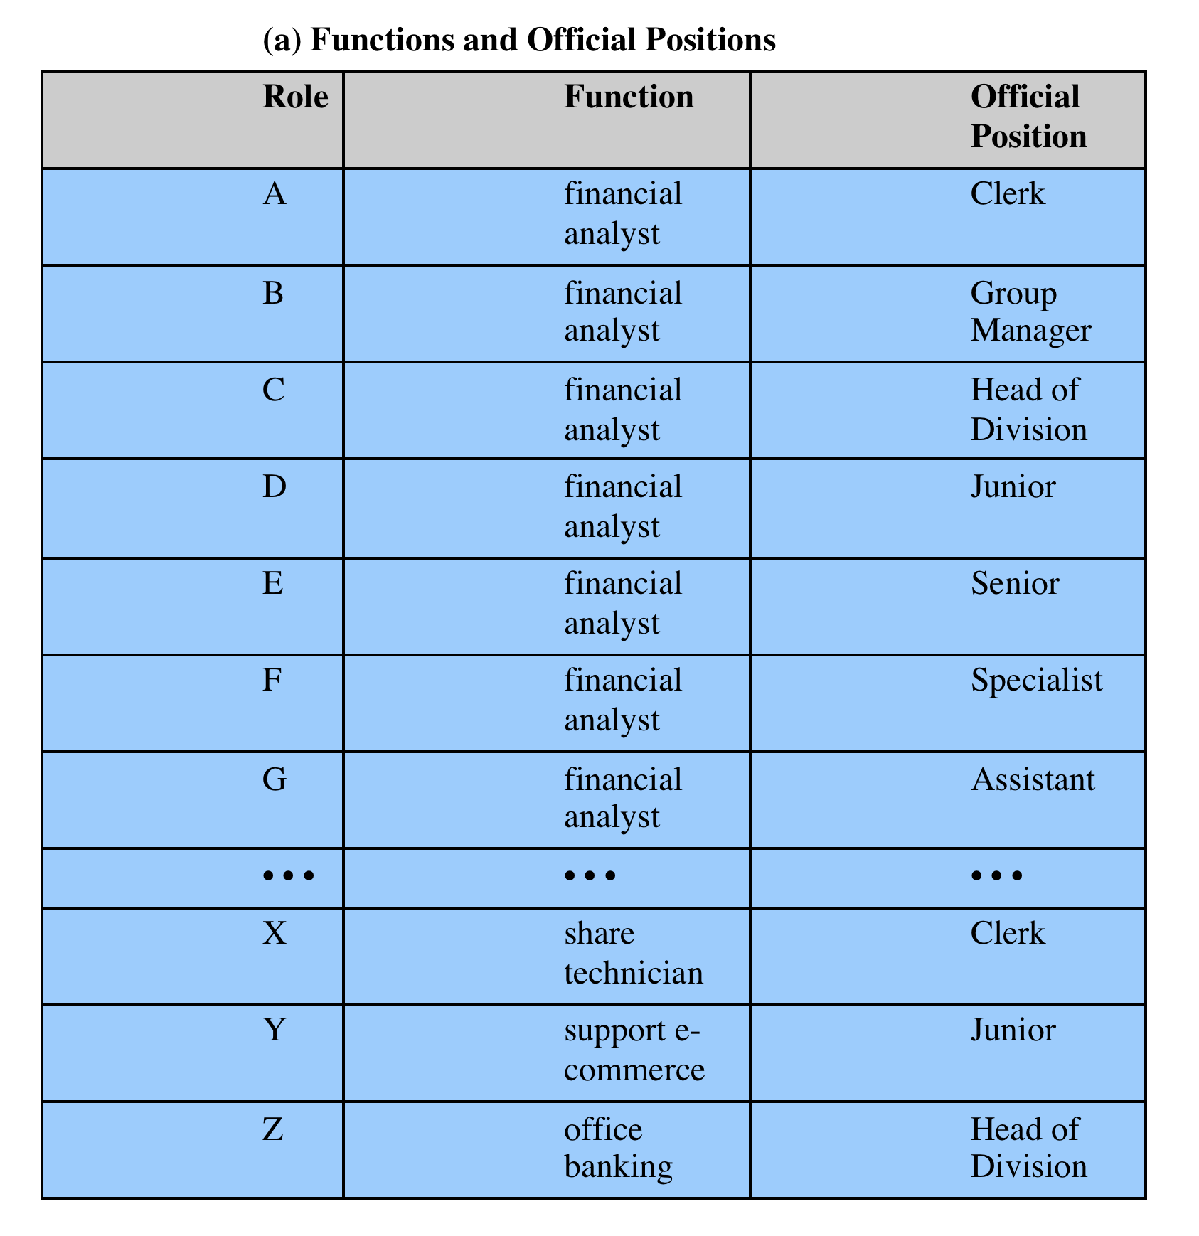
Table 4.5
Functions and Roles for Banking Example
Notes:
The Dresdner Bank has implemented an RBAC system that serves as a useful practical
example [SCHA01]. The bank uses a variety of computer applications. Many
of these were initially developed for a mainframe environment;
some of these older applications are now supported on a client-server network while others
remain on mainframes. There are also newer applications
on servers. Prior to 1990, a simple DAC system was used on each server and mainframe. Administrators
maintained a local access control file on each host and defined the access rights for each employee
on each application on each host. This system was cumbersome, time-consuming,
and error-prone. To improve the system, the bank introduced an RBAC scheme,
which is systemwide and in which the determination of access rights is compartmentalized
into three different administrative units for greater security.
Roles within the organization are defined by a combination of official position
and job function. Table 4.5a provides examples. This differs somewhat from the
concept of role in the NIST standard, in which a role is defined by a job function.
To some extent, the difference is a matter of terminology. In any case, the bank’s
role structuring leads to a natural means of developing an inheritance
hierarchy based on official position.

Slide 46
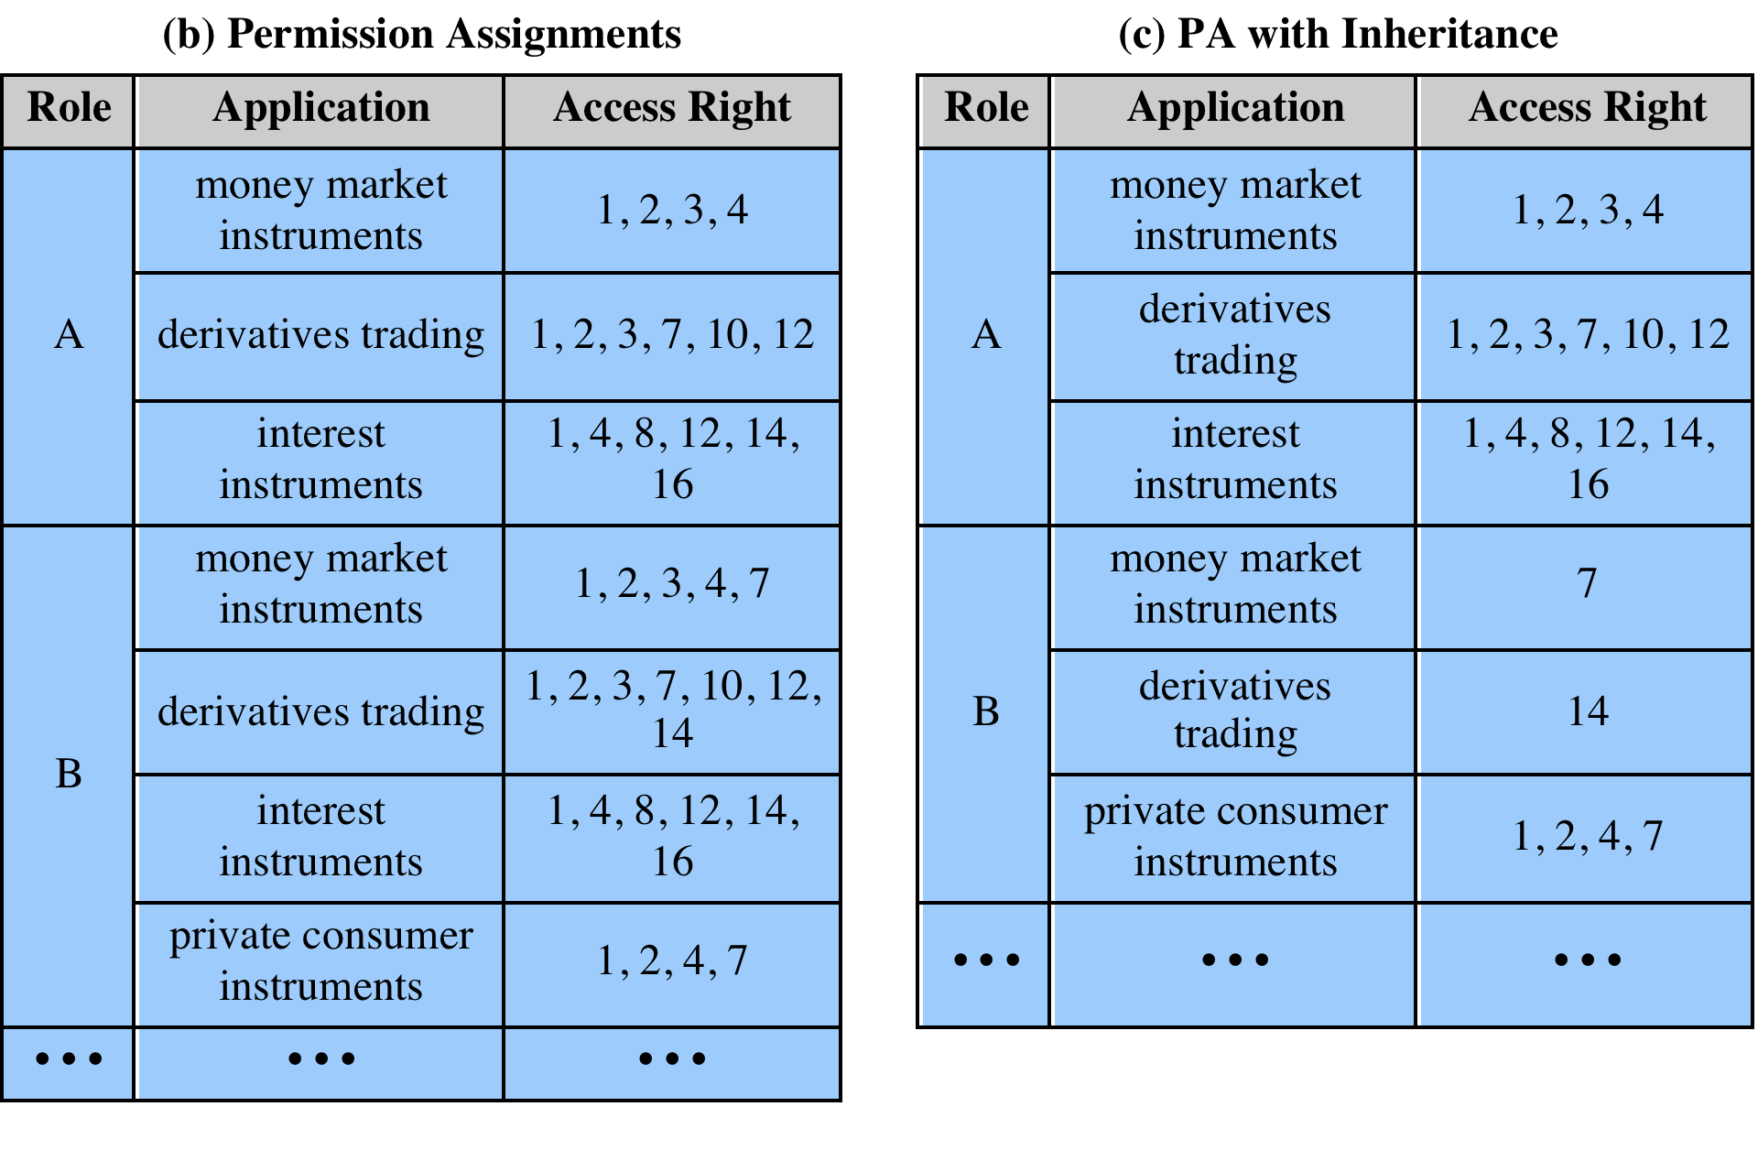
Table 4.5
Functions and Roles for Banking Example
Notes:
Within the bank, there is a strict partial ordering of
official positions within each organization, reflecting a hierarchy of responsibility
and power. For example, the positions Head of Division, Group Manager, and
Clerk are in descending order. When the official position is combined with job function,
there is a resulting ordering of access rights, as indicated in Table 4.4b. Thus,
the financial analyst/Group Manager role (role B) has more access
rights than the financial analyst/Clerk role (role A). The table indicates that role B has as many or
more access rights than role A in three applications and has access rights to a fourth
application. On the other hand, there is no hierarchical relationship between
Office banking/Group Manager and financial analyst/Clerk because they work in different
functional areas. We can therefore define a role hierarchy in which one role is superior
to another if its position is superior and their functions are identical. The role
hierarchy makes it possible to economize on access
rights definitions, as suggested in Table 4.5c.

Slide 47
Notes:
In the original scheme, the direct assignment of access rights to the individual
user occurred at the application level and was associated with the individual
application. In the new scheme, an application administration determines the set of access rights associated
with each individual application. However, a given user performing a given task
may not be permitted all of the access rights associated with the application. When a
user invokes an application, the application grants access on the basis of a centrally provided
security profile. A separate authorization administration associated access rights
with roles and creates the security profile for a use on the basis of the user’s role.
A user is statically assigned a role. In principle (in this example), each user
may be statically assigned up to four roles and select a given role for use in invoking
a particular application. This corresponds to the NIST concept of session. In practice,
most users are statically assigned a single role based on the user’s position and
job function.
All of these ingredients are depicted in Figure 4.14. The Human Resource
Department assigns a unique User ID to each employee who will be using the system.
Based on the user’s position and job function, the department
also assigns one or more roles to the user. The user/role information is provided to the Authorization
Administration, which creates a security profile for each user that associates the
User ID and role with a set of access rights. When a user invokes an application,
the application consults the security profile for that user to determine what subset of
the application’s access rights are in force for this user in this role.
A role may be used to access several applications. Thus, the set of access
rights associated with a role may include access rights that are not associated with one
of the applications the user invokes. This is illustrated in Table 4.4b. Role A has
numerous access rights, but only a subset of those rights are applicable to each of the
three applications that role A may invoke.
Some figures about this system are of interest. Within the bank, there are 65
official positions, ranging from a Clerk in a branch, through the Branch Manager,
to a Member of the Board. These positions are combined with 368 different job
functions provided by the human resources database. Potentially, there are 23,920
different roles, but the number of roles in current use is about 1,300. This is in line
with the experience other RBAC implementations. On average, 42,000 security
profiles are distributed to applications each day by the Authorization Administration
module.

Slide 48
Summary
Access control principles
Access control context
Access control policies
Subjects, objects, and access rights
Discretionary access control
Access control model
Protection domains
UNIX file access control
Traditional UNIX file access control
Access control lists in UNIX
Role-based access control
RBAC reference models
Attribute-based access control
Attributes
ABAC logical architecture
ABAC policies
Identity, credential, and access management
Identity management
Credential management
Access management
Identity federation
Trust frameworks
Traditional identity exchange approach
Open identity trust framework
Bank RBAC system
Notes:
Chapter 4 summary.

